Slide 1
O.S Concepts
Threads
Process synchronization
Deadlocks

Slide 2
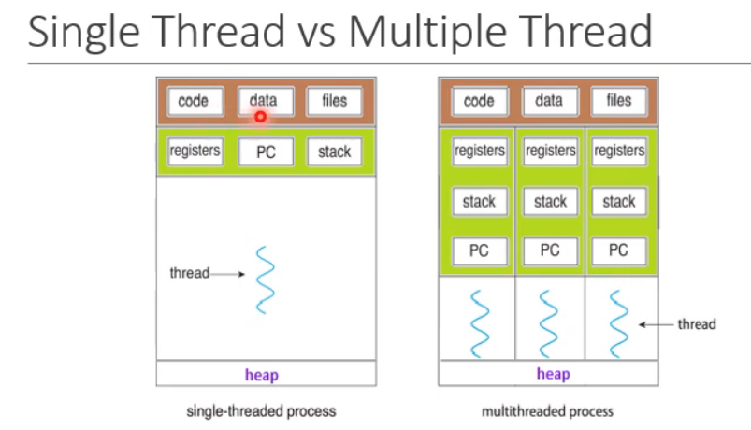
Threads
Single thread vs multiple thread
Multi core architecture
Types of threads 1.user level
2.kernel level
Multi threading models:
many to one: solaris green thread
one to one : linux,windows
3. many to many:windows fiber API
Threading issues:
1.fork() and exec()
2. thread cancellation- asynchronous and deferred cancellation
3.signal handling- default and user-defined signal handling
4.thread local storage.

Slide 3
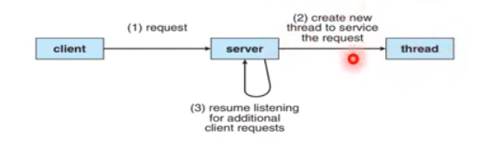
Threads
Application :
multi threaded web server

Slide 4
Mutual exclusion and synchronization
Producer-consumer problem:
Race condition
Process synchronization: to co-ordinate co-operating processes in a manner that no two processes can have acess to the same shared data and resources.
Critical section: contains shared variables which need to be synchronized to maintain consistency of data.
critical condition
do{
entry section
//critical section
exit section
//remainder section
}while(TRUE);

Slide 5
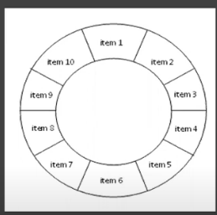
#define BUFFER_SIZE 10
typedef struct {
....
} item;
item buffer[BUFFER_SIZE];
int in = 0;
int out = 0;
int counter =0;
//producer process
while(true){ //produce an item in next produced
while(counter == BUFFER_SIZE); // do nothing
buffer[in] = next_produced;
in = (in+1) % BUFFER_SIZE;
counter++;
}
//consumer process
while(true){
while(counter == 0); //do nothing
next_consumed = buffer[out];
out = (out+1) % BUFFER_SIZE; /increase the out pointer
counter--; //consume the item in next consumed
}

Slide 6
Mutual exclusion and synchronization
Criteria for critical section problem: must satisfy 3 conditions
1.Mutual exlclusion 2. Progress 3.Bounded waiting
Petersons solution: software based solution only for 2 processes
It has two variables 1.int turn; 2.boolean flag[2];
do
{
flag[i] = true;
turn =j;
while(flag[j] && turn ==j);
//critical section
flag[i] = false;
//remainder section
}while(true);
Semaphore is a synchronization tool used for multiple processes.

Slide 7
Deadlock and starvation
Each process utilizes a resource by 3 ways 1.request 2. use 3. release
Deadlock characterization : 4 conditions
1.Mutual exclusion 2.hold &wait 3.no preemption 4.circular wait
Methods for handling deadlocks:
1. ensure that the system will never enter a deadlock state
1.deadlock prevention 2.deadlock avoidance
2.allow the system to enter a deadlock state and then recover

Slide 8
Deadlock avoidance
Deadlock avoidance: it examines the resource allocation state to ensure that there can never be a “circular-wait-condition”.
Safe state: no deadlocks
Deadlock avoidance algorthim:
Single instance of a resource type use a “modified resource allocation graph”.
Multiple instances of a resource type use the “bankers algorithm”

Slide 9
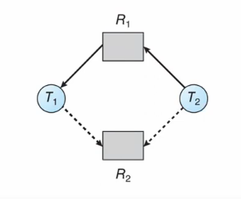
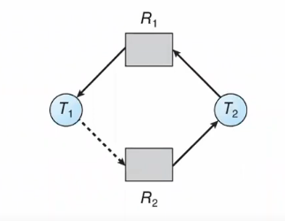
Deadlock avoidance algorithms
Modified resource allocation graph:
1.Claim edge : Pi->Rj, may request resource Rj
2. request edge : Pi->Rj, request resource Rj
3. assignment edge: Rj->Pi,resource Rj was allocated
to process Pi
Unsafe state: may lead to deadlock
Bankers algorithm:
1.Available: available[j] = k;
2.Max: n*m matrix , Max[i,j] = k;
3.Allocation : allocation[i,j] = k;
4.Need : need[i,j] = k;

Slide 10
Deadlock avoidance algorithms
Safety algorithm:
Let work and finish be vectors of length m and n, respectively
initialize: work = available
finish[i] = false for i=0,1,2,…….n-1
2. Find an i such that both: finish[i] = false
Needi <= work
if no such i exists, goto step 4
3. Work = work + allocation;
finish[i] = true
goto step 2
4. If finish[i] == true for all i, then the system is in safe state.

Slide 11
Deadlock avoidance algorithms
Resource – Request Algorithm:
If reqi = request vector for process i, if reqi [j] = k means process Pi wants k instances of resource type Rj
If reqi <= Needi , goto step2
If reqi<= available, goto step3
Available = Available – Request;
Allocation = Allocationi + Requesti;
Needi = Needi – Requesti;
Algorithm is invoked upon every resource request from the processes.
If safe : the resources are allocated to Pi
If unsafe : Pi must wait, and old resource allocation state is restored.

Slide 12
Deadlock avoidance algorithms
Example of Bankers Algorithm:
Let take 5 processes P0 through P4 and 3 resource types: A(10 instances), B(5 instances) and C(7instances)
At time T0:
Needi = Maxi – Allocationi
P0 - 743<=332
P1 - 122<=332
Available-need=332-122=210
Allocation+need=200+122=322
Available resources=210+322=532
The system is in safe state
<P1,P3,P4,P2,P0> satisfies
Safety criteria
 | Allocation | Max | Available | Need
 | ABC | ABC | ABC | ABC
P0 | 010 | 753 | 332 | 743
P1 | 200 | 322 |  | 122
P2 | 302 | 902 |  | 600
P3 | 211 | 222 |  | 011
P4 | 002 | 433 |  | 431

Slide 13
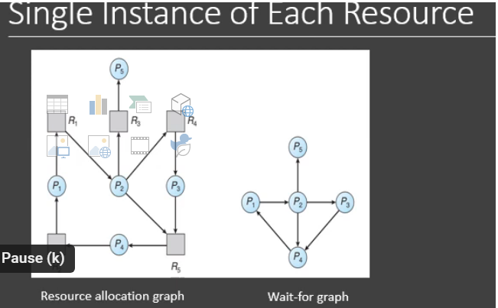
Deadlock detection
Absence of deadlock prevention or deadlock avoidance algorithm, a deadlock may occur
Solution is
1. detection algorithm
for single instane –
wait for graph
for multiple instance –
detection algorithm
2.recovery scheme

Slide 14
Deadlock detection algorithms
Detection algorithm:
Let work and finish be vectors of length m and n, respectively
initialize: work = available
for i = 1,2,3, …..n if allocation != 0 then finish[i] = false; else finish[i] = true;
2.Find a index i such that both:
finish[i] = = false
requesti <= work
If no such i exists, goto step 4
3.Work = work+allocation;
finish[i] = true;
goto step2
4.If finish[i] == false, for some i, 1<=i<=n, then the system is in deadlock state. Moreover , if finish[i]==flase, then Pi is deadlocked.

Slide 15
Deadlock avoidance algorithms
Example of detection algorithm:
Lets take 5 processes P0 through P4, 3 resource types A(7 instances), B(2 instances) and C(6 instances)
Available resource = available+
allocation
At P0 available resources is 010
At P2 available resources is 010+302=312
At P3, 312-100=212,212+211=423
Sequence <P0,P2,P3,P1,P4> will
result in finish[i] = true for all i
 | Allocation | Request | Available
 | ABC | ABC | ABC
P0 | 010 | 000 | 000
P1 | 200 | 202
P2 | 302 | 000
P3 | 211 | 100
P4 | 002 | 002

Slide 16
Deadlock recovery methods
Two recovery approaches:
Inform the operator and let the operator deal with the deadlock manually.
System recovers from the deadlock automatically.
Two options for deadlock recovery
Process termination
Pre-empt some resources
Process termination:
Abort all the deadlocked processes
Abort one process at a time until the deadlock is eliminated.
Resource pre-emption:
Selecting a victim
Rollback
starvation

